Slide 1





TRAFFIC MANAGEMENT
Team : Yashwath kumar.B
Email : yashwathkumar14@gmail.com
Guide: (P.Raja, Master Trainer )
Disclaimer: The content is curated for educational purposes only.
Notes:
Slides: Prepare a short slide deck (10-12 slides) summarizing the project objectives, methodology, and key results.

Slide 2
OUTLINE
Abstract
Problem Statement
Proposed System/Solution
Algorithm & Deployment
GitHub Link
Project Demo(photos / videos)
Conclusion
Future Scope
References

Slide 3
Problem Statement
This project aims to address these challenges by utilizing advanced machine learning techniques to develop accurate, data-driven traffic prediction models. The focus is on leveraging Artificial Neural Networks (ANN) and Recurrent Neural Networks (RNN) to analyze historical traffic data and make real-time predictions. These models will provide insights that support better decision-making in traffic management, enabling proactive responses to congestion and improving overall efficiency in urban transportation systems.

Slide 4
Abstract
This report examines recent advances in traffic management prediction using machine learning and AI. It investigates methods such as Artificial Neural Networks (ANN), Time Series Linear Models (TSLM), and Recurrent Neural Networks (RNN), each suited for different aspects of traffic prediction. We analyze the strengths and limitations of each method and evaluate them to determine the best approaches for accurate, real-time traffic prediction and management.

Slide 5
Proposed Solution
To address the complexities of urban traffic management and improve real-time traffic flow prediction, this project proposes a machine learning-based approach that leverages Artificial Neural Networks (ANN) and Recurrent Neural Networks (RNN). These models are chosen for their capability to analyze complex, nonlinear patterns in traffic data and handle the temporal dependencies in sequential data, which is crucial for understanding traffic flow over time.

Slide 6
Github project link
https://github.com/yashwathkumar/naan-mudhalvan.git
Notes:
thank you very much for joining this PPT, keep learning.
6

Slide 7
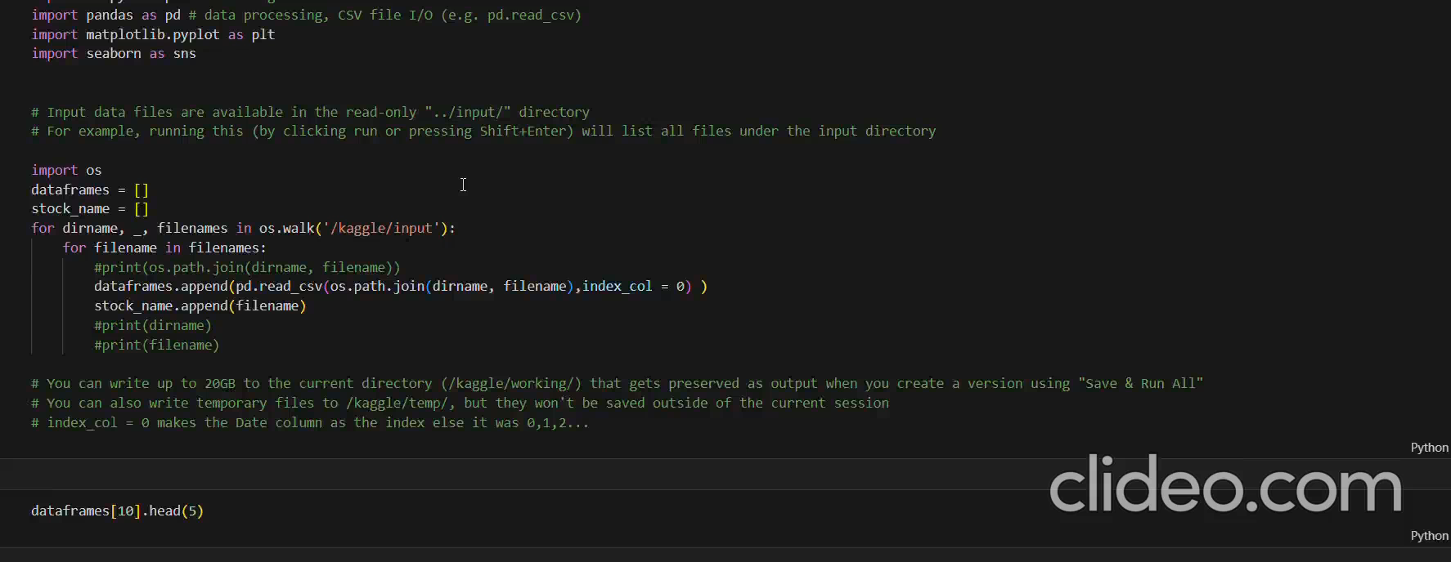
Video of Project Demo

Slide 8
Conclusion
In conclusion this project demonstrates the potential of machine learning in improving urban traffic management. With ongoing development, these models could form the foundation of intelligent traffic systems that reduce congestion, enhance public safety, and contribute to smarter, more sustainable urban environments.

Slide 9
Future Scope
Real-Time Data Integration
Hybrid Model Development
entiment Analysis and Social Media Data
Edge Computing and Distributed Systems
Expansion to Multi-Modal Traffic Prediction

Slide 10
Thank you!
Notes:
thank you very much for joining this PPT, keep learning.
10

